Slide 1
Ways to optimize SPFx highly customized Intranet homepage
Velin Georgiev
Software Architect
@VelinGeorgiev

Slide 2

About me
Velin Georgiev
Software Architect, IceWolf.ie
What I do in business
Anything else?
Twitter: @VelinGeorgiev
Website: IceWolf.ie
Blog: https://blog.velingeorgiev.com

Slide 3
Agenda
Real customer case
A way to analyze the page performance
SPFx package size matters
A way to cache data on the browser
A way to move logic from the client to the server
Change the way you work (upfront savings)

Slide 4
Why?

Slide 5
Why?
47% of customers expect a webpage to load in 2 seconds or less.
Notes:
Poor website performance destroys brand perception
Mobify found that decreasing their homepage's load time by 100 milliseconds resulted in a 1.11% uptick in session-based conversion
Retailer AutoAnything experienced a 12-13% increase in sales after cutting page load time in half
Walmart discovered that improving page load time by one second increased conversions by 2%

Slide 6
Real customer Intranet case
How is the homepage looking?

Slide 7
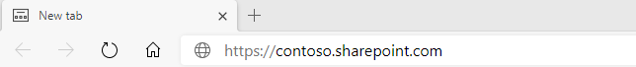



Intranet home page
Custom Navigation Link 1 | Link 2 | Link 3
2.0 – 2.4 M
hits per month
Global Company News Carousel
News Title 1
News Title 1
News Title 1

Slide 8
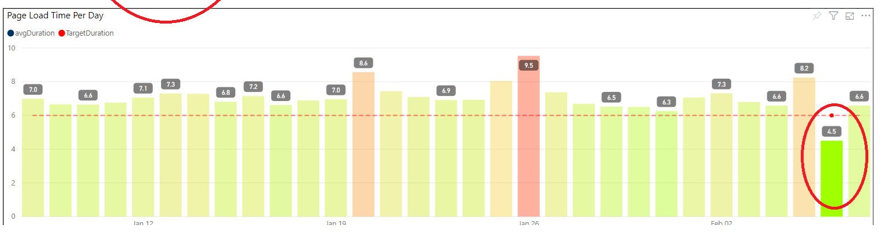
What were the metrics showing?
Before
After

Slide 9
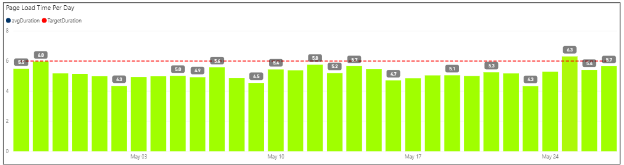
What were the metrics showing?
After

Slide 10
Why are the metrics so bad?
Corporate proxy
Home office from a remote place
Internet Explorer
Antivirus Software
Poor hardware
or poor virtualization
Chrome extensions
Poor VPN

Slide 11
Why are the metrics so bad?
while(true)
{
console.log(“blocked”)
}

Slide 12
Intranet home page
- Communication site
Custom Navigation Link 1 | Link 2 | Link 3
- Modern SPFx Site Page
Global Company News Carousel
News Title 1
News Title 1
News Title 1
- 34 Features encapsulated
in SPFx components
- Highly personalized content

Slide 13
Intranet home page
Show data stored
in Cosmos DB
- Azure App to move content
Custom Navigation Link 1 | Link 2 | Link 3
Global Company News Carousel
App Insights
to track user interaction
News Title 1
News Title 1
News Title 1
Integration
with internal systems

Slide 14
SPFx parts
SPFx App Customizer
Custom Navigation Link 1 | Link 2 | Link 3
Global Company News Carousel
News Title 1
News Title 1
News Title 1
SPFx App Web Part
Notes:
Images source: https://unsplash.com
https://unsplash.com/photos/MYbhN8KaaEc
https://unsplash.com/photos/cckf4TsHAuw

Slide 15
SPFx parts
SPFx App Customizer
Custom Navigation Link 1 | Link 2 | Link 3
SPFx App Web Part
Global Company News Carousel
User’s Business Unit News Carousel
SPFx App Web Part
Business unit title 1
Business unit title 1
Business unit title 1
Notes:
Images source: https://unsplash.com
https://unsplash.com/photos/MYbhN8KaaEc
https://unsplash.com/photos/cckf4TsHAuw

Slide 16
SPFx parts
SPFx App Customizer
Custom Navigation Link 1 | Link 2 | Link 3
SPFx App Web Part
Global Company News Carousel
SPFx App Web Part
User’s Business Unit News Carousel
User’s subscriptions
SPFx App Web Part
Subscription 1 title
Subscription 2 title
Subscription 3 title
Notes:
Images source: https://unsplash.com
https://unsplash.com/photos/MYbhN8KaaEc
https://unsplash.com/photos/cckf4TsHAuw

Slide 17
SPFx parts
SPFx App Customizer
Custom Navigation Link 1 | Link 2 | Link 3
SPFx App Web Part
Global Company News Carousel
User’s Business Unit News Carousel
SPFx App Web Part
User’s subscriptions
SPFx App Web Part
Company events
SPFx App Web Part
Business unit title 1
Business unit title 1
Business unit title 1
Notes:
Images source: https://unsplash.com
https://unsplash.com/photos/MYbhN8KaaEc
https://unsplash.com/photos/cckf4TsHAuw

Slide 18
SPFx parts
SPFx App Customizer
Custom Navigation Link 1 | Link 2 | Link 3
SPFx App Web Part
Global Company News Carousel
User’s Business Unit News Carousel
SPFx App Web Part
User’s subscriptions
SPFx App Web Part
Company events
SPFx App Web Part
Business unit title 1
Business unit title 1
Business unit title 1
SPFx App Customizer
Custom Footer Link 1 | Link 2 | Link 3
Notes:
Images source: https://unsplash.com
https://unsplash.com/photos/MYbhN8KaaEc
https://unsplash.com/photos/cckf4TsHAuw

Slide 19
The Process
Analyze
Identify area of improvements
Make proof of concepts
Measure the performance
Deploy

Slide 20
Way to analyze the page performance
Chromium developer tools is a simple, effective way to do it

Slide 21
SPFx package size matters
Packages, external scripts and Webpack bundle analyzer

Slide 22
Webpack bundle analyzer
- https://docs.microsoft.com/en-us/sharepoint/dev/spfx/toolchain/optimize-builds-for-production
PnP SPFx Generator
https://pnp.github.io/generator-spfx/

Slide 23
A way to cache data on the browser
Client storage options

Slide 24


Cache data on the client that is not critical
User Profiles Service
Browser
200 ms
Wait for user profile data to return
(Blocking) … then …
SharePoint list api
600 ms
Get list items

Slide 25


Cache data on the client that is not critical
200 ms

Slide 26
Cache data on the client that is not critical
2 ms

Slide 27
Cache data on the client that is not critical
Session Storage
Local Storage
Indexed DB
2 ms

Slide 28
Ways to move logic from the client to the server
Azure Functions

Slide 29
Why a server?
8 web requests
Custom Navigation Link 1 | Link 2 | Link 3
3 web requests
Global Company News Carousel
User’s Business Unit News Carousel
4 web requests
User’s subscriptions
4 web requests
Company events
2 web requests
Business unit title 1
Business unit title 1
Business unit title 1
2 web requests
Custom Footer Link 1 | Link 2 | Link 3
23 web requests in total

Slide 30

Aggregate data on the server
Azure WebJob
every 9 mins
20 web requests
Pre-Processing data
300 ms
instead of
2 sec
Single JSON file 295 kB (GZIP 49.6 kB)

Slide 31
Change the way you work
Create a team manifest
Use pull requests
Create small pull requests more often
Review the pull requests
Include unit tests
Use DevOps pipeline to fail build on unit test fail
Do not let vendor deliver package without review

Slide 32
Additional
- Remove ADALJS, SPFx has build in mechanism for calling 3rd party APIs
- Use your own CDN (not the Office 365 CDN) for better cache control
- Decommission Internet Explorer
- Long and short polling in JavaScript will destroy your page performance
- SharePoint Framework performance optimization list
https://blog.velingeorgiev.com/sharepoint-framework-performance-optimization

Slide 33
Libraries and tools for client cashing
Consider native apis
https://github.com/localForage/localForage
https://github.com/marcuswestin/store.js
https://github.com/gruns/ImmortalDB
PnP Sample
https://github.com/pnp/sp-dev-fx-webparts/tree/master/samples/react-offline-first

Slide 36
The source from the presentation
https://github.com/VelinGeorgiev/Ways-to-Optimzie-SPFx-Demos

Slide 37
Notes for the speakers
Hey! Here are some tasks for you
Choose one of the four Title slide templates for your cover slide
Fill in the Session Title and your personal information
Go to View -> Slide Master and update the speaker’s picture with yours
Update the speaker’s picture in the “About me” slide
And provide some useful information about yourself …
Never mind about the “impostor syndrome” ☺
Save the presentation file naming it like
FirstName-LastName-Session-Title.pptx
Record the video of your session (MP4 Full HD 1920x1080)
Name the video file like
FirstName-LastName-Session-Title.mp4
Remember that sessions last 30 minutes (no more, no less ☺!)
Upload your presentation and video
Deadline? August 21st 2020 (please …)
Where? Teams channel dedicated to the PnP Virtual Conference, use the “September-2020-Edition” target folder
Have fun and thank you!

